Slide 1
URL Shortener
By- Pranjal Tripathi
IT-73

Slide 2
Abstract
This is for in partial fulfilment for the award of the degree B. Tech at Shri Ramswaroop Memorial College of Engineering and Management. This internship mainly covers “The Complete 2021 Web Development Bootcamp” at an online learning platform named, UDEMY Inc. In this internship main focus was on technologies like “HTML, CSS, JavaScript, MongoDB, Node.Js.” These technologies tend to solve real life problems in web development domain like, Creating a website From Front-end (UI-Part) to Connecting it with Back-end (Server-Part) including the synchronisation with database(MongoDB & MySQL).

Slide 3
Introduction
In today’s growing world, almost every single thing is directly or indirectly done by a Website, In our day-to-day life we access website using some URL, these URL’s are sometime quite long to remember and for an Average person it may be painful, to overcome this kind of difficulty URL Shorteners are used.
URL shortening is a technique on the World Wide Web in which a Uniform Resource Locator (URL) may be made substantially shorter and still direct to the required page. This is achieved by using a redirect which links to the web page that has a long URL.

Slide 4
Objectives to be discussed:
Description of technology
Problem study/methodology
Activity Diagrams
Explanation of experimental data

Slide 5
Description of technology:
This website is developed using Node.js (Express Framework). It is a back end web application framework for Node.js, released as free and open-source software under the MIT License. It is designed for building web applications and APIs.
1812213072

Slide 6
Problem study:
https://slicedurl.herokuapp.com generates a short URL corresponding to a long URL. URL shortening is a technique on the World Wide Web in which a Uniform Resource Locator (URL) may be made substantially shorter and still direct to the required page. This is achieved by using a redirect which links to the web page that has a long URL. For example, the URL "https://www.udemy.com/course/the-complete-web-development-bootcamp/learn/lecture/12385812#overview/" can be shortened to" https://slicedurl.herokuapp.com/46acdp“.
1812213072

Slide 7
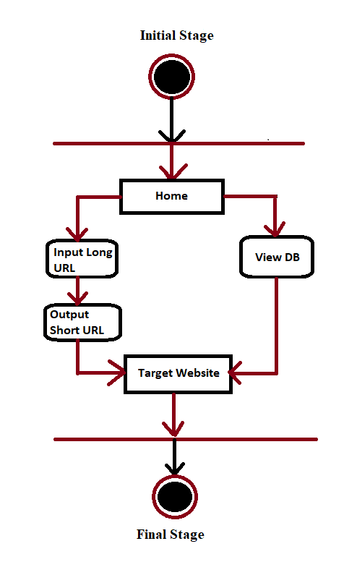
Activity Diagrams:
1812213072

Slide 8
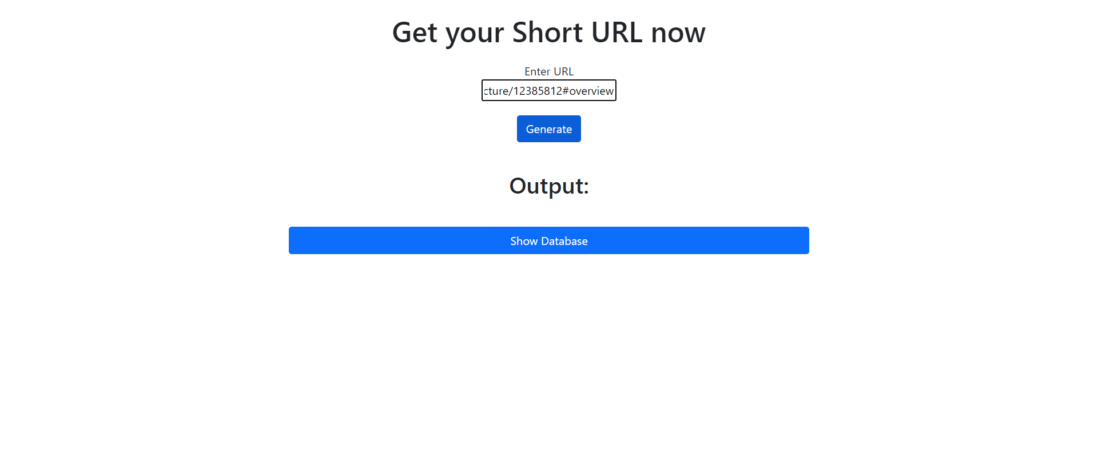
input:

Slide 9
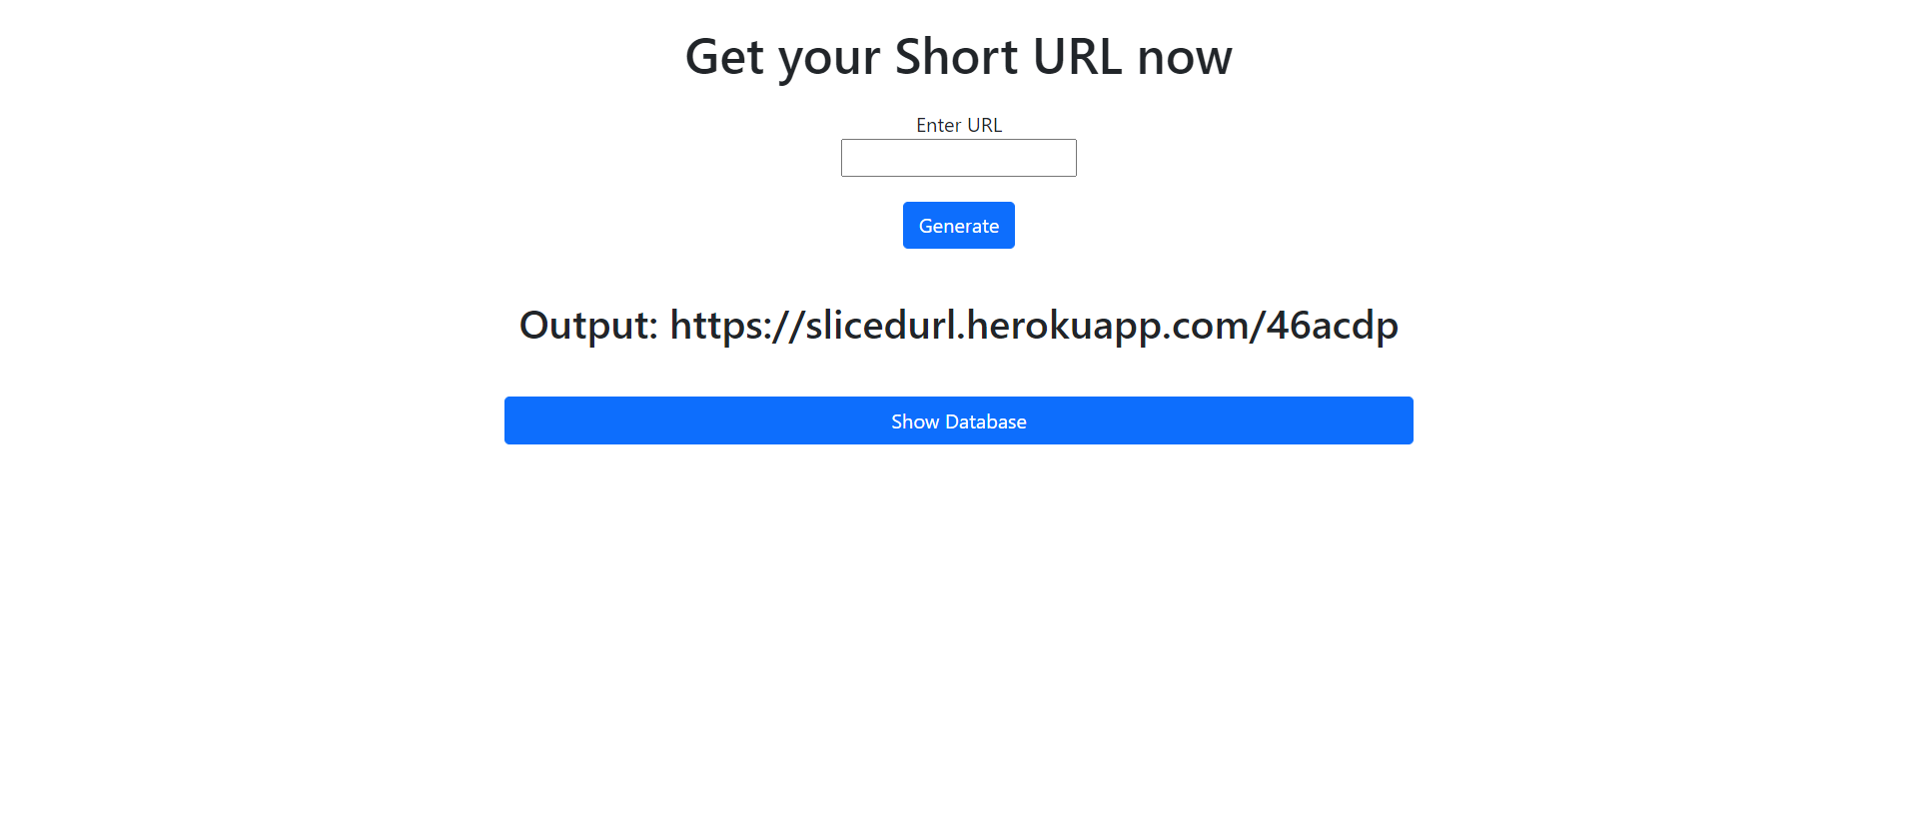
Output:

Slide 10
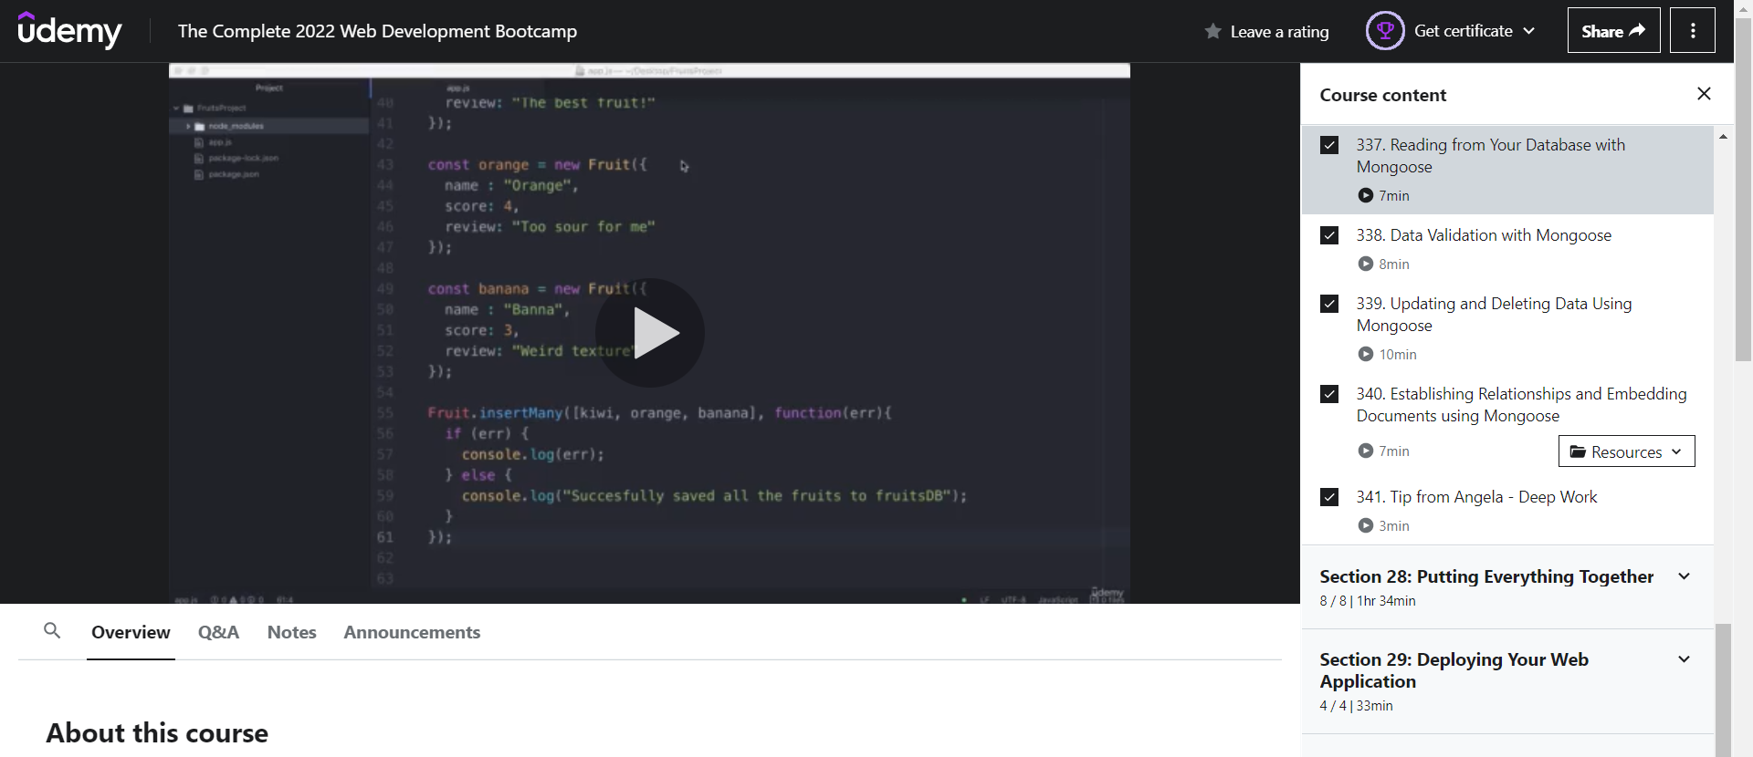
Redirected page:
1812213072

Slide 11
explanation of experimental data:
The inputs consist of a query and the output consists of the solutions for the query. In this project the input will be the query as fired by the user is Long URL. Now the output will be visible as Short URL. Previously generated Short URLs can also be accessed when user requests the server to show database.

Slide 12
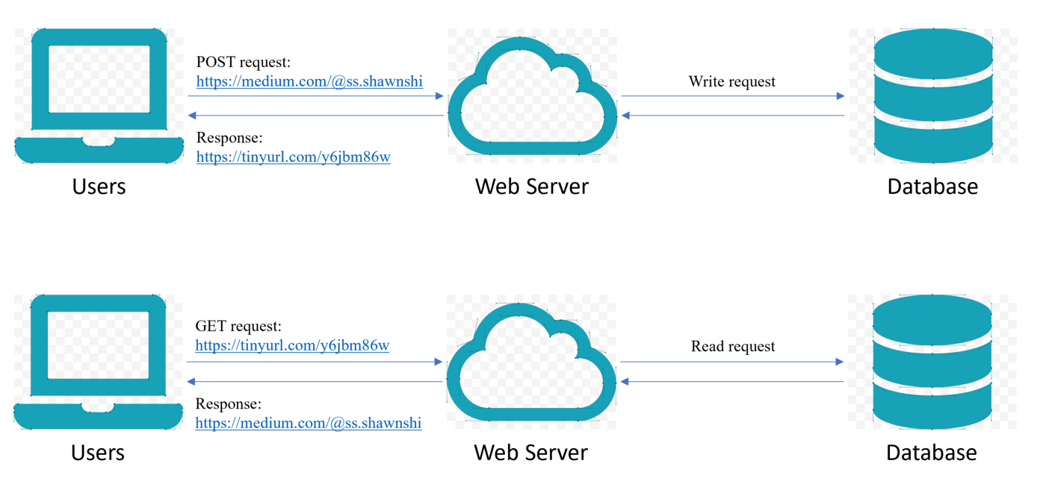
Conclusion:
Sliced URL (https://slicedurl.herokuapp.com) is being developed to have easy short names for long URLs to easily excess websites.

Slide 13
References
[1] London App Brewery. How to Download & Install MongoDB on Windows. 2018
Available at: https://medium.com/@LondonAppBrewery/how-to-download-install-mongodb-on-windows-4ee4b3493514 .
[2] GeeksForGeeks. Unified Modeling Language (UML) | Activity Diagrams. 2018
Available at: https://www.geeksforgeeks.org/unified-modeling-language-uml-activity-diagrams/#:~:text=An%20activity%20diagram%20is%20a,the%20activity%20is%20being%20executed .
[3] Pheonixnap. How to Install Node.js and NPM on Windows. 2019
Available at: https://phoenixnap.com/kb/install-node-js-npm-on-windows .
[4] Wikipedia. URL shortening. 2021
Available at: https://en.wikipedia.org/wiki/URL_shortening .
[5] FreeCodeCamp. How to deploy your app to the web using Express.js and Heroku. 2020
Available at: https://www.freecodecamp.org/news/how-to-deploy-your-site-using-express-and-heroku
[6] London App Brewery. VS Code Installation Steps. 2021
Available at: https://docs.google.com/document/d/e/2PACX-1vQDcdmrkjNPlOSeqS-v99P-57h5f7Yo3pszkko1sN6OtIVlNBFgTyeTX3A1mDSOdw1Ugb1l5o0NVy-a/pub
[7] MDN Docs. The Form element. 2021
Available at: https://developer.mozilla.org/en-US/docs/Web/HTML/Element/form.
1812213072

Slide 14
Acknowledgement
It is a great pleasure for me to acknowledge the assistance and contributions of individuals.
To compleand deal with a practical world is not so easy work if not get support by others. Therefore, I feel grateful to and wish my profound indebtedness to Er. Anjani Kumar, Assistant Professor, Department of IT, Shri Ramswaroop Memorial College of Engineering and Management, Lucknow.
And finally but immensely express my utmost gratitude to my parents for their love and support, affection and inspiration. Without them, I would not have been able to complete this project.

Slide 15

THANK YOU !

